Slide 1
Coming Attractions
For Fitness Enthusiasts
And Thrill Seekers

Slide 2
Zip Line!

Slide 3
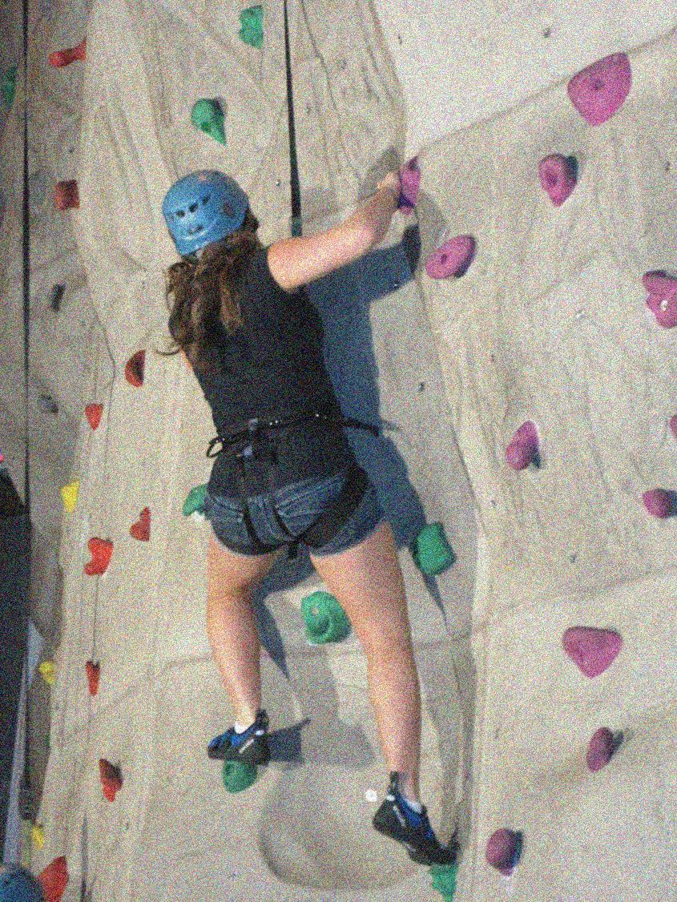
Rock Climbing at Santa Clara Park
Indoor facility
3,000 square feet of sculptured climbing walls
State-of-the-art structures and climbing holds
Classes
Beginner Power Up
Intermediate Gravity Defiance
Advanced Agility and Strength

Slide 4
Regulations
Footwear requirements
For the zip line, shoes with laces
For climbing, rock-climbing shoes are required and may be rented at the facility
Zip line height requirement is 42 inches
Rock climbers must be at least 6 years old
Children under age 12 may only climb with a parent or guardian present
Minors age 12 to 17 must have a waiver signed by their parent on file
Signed liability waivers are required

Slide 5
Are You Ready

